Slide 1

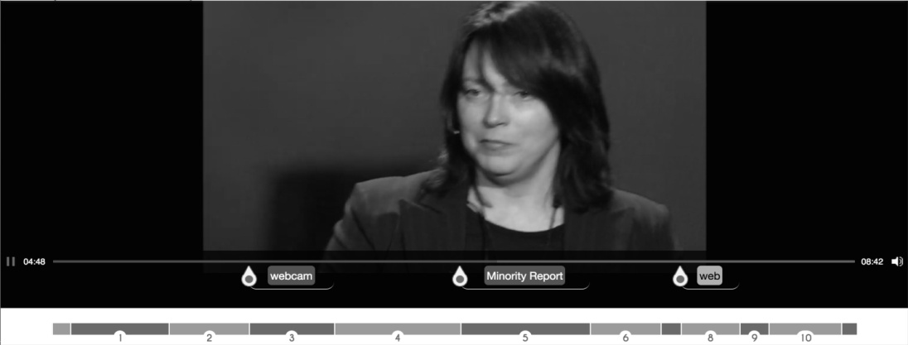
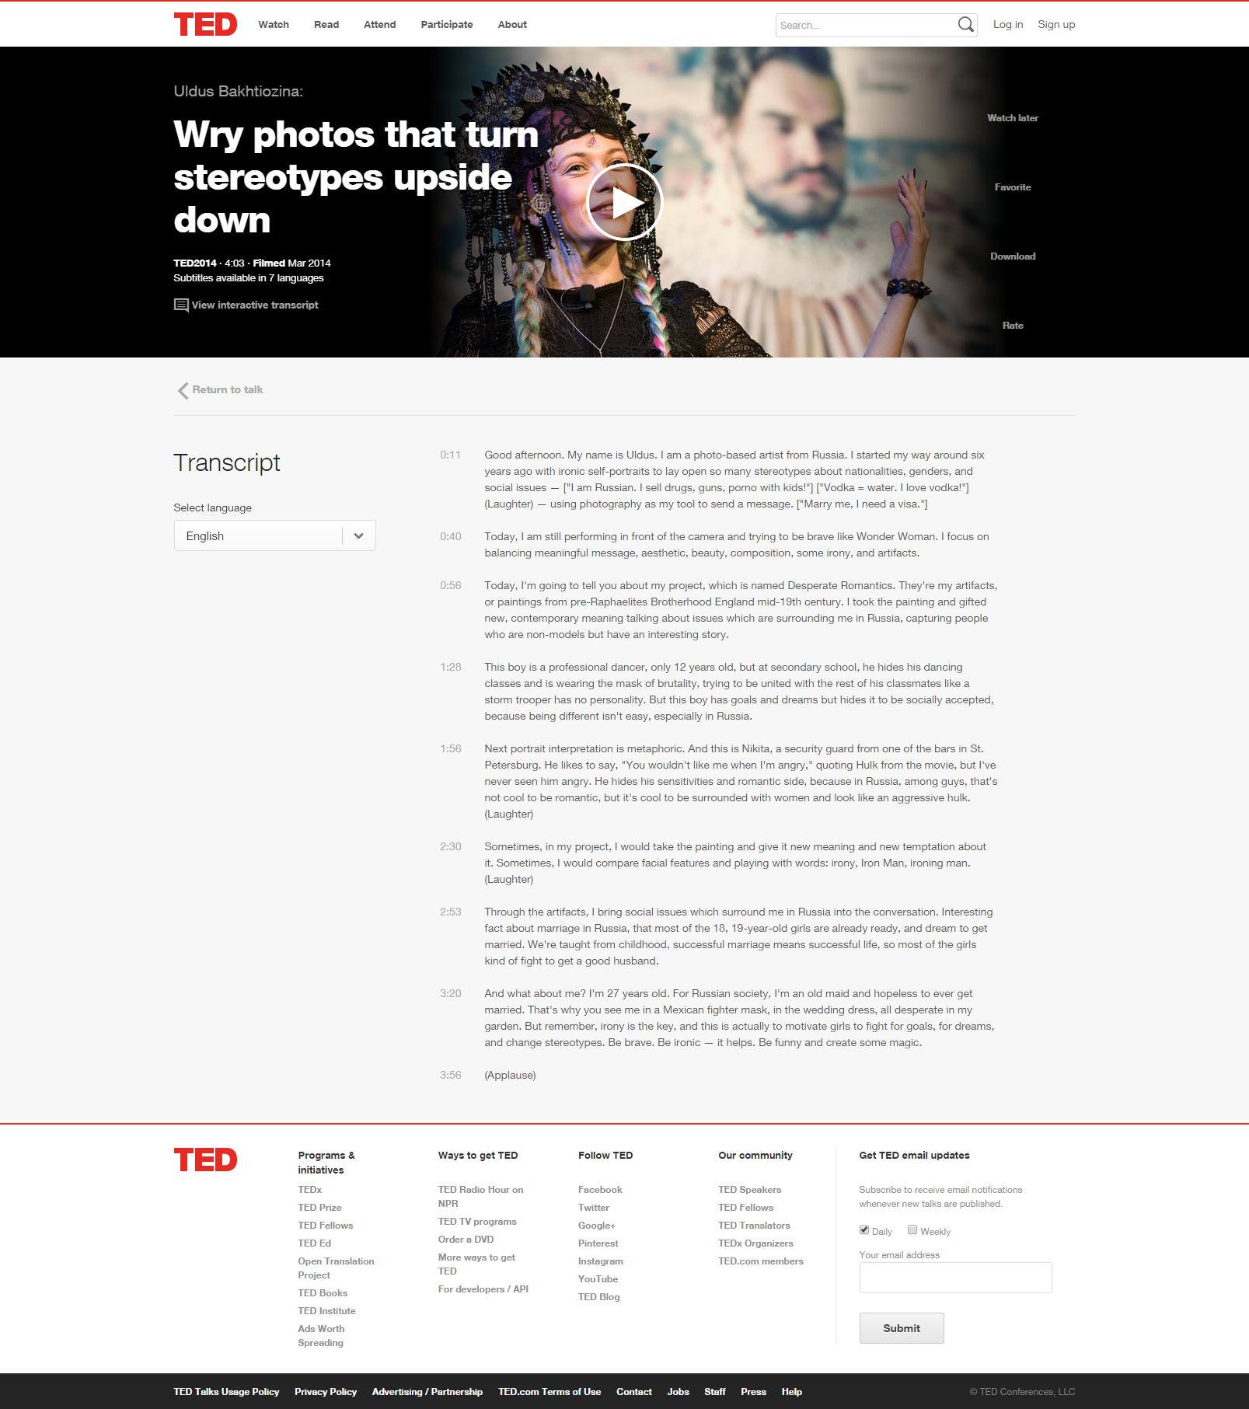


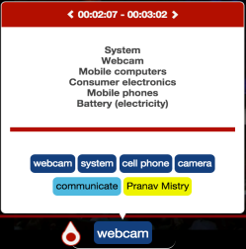
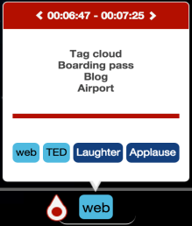
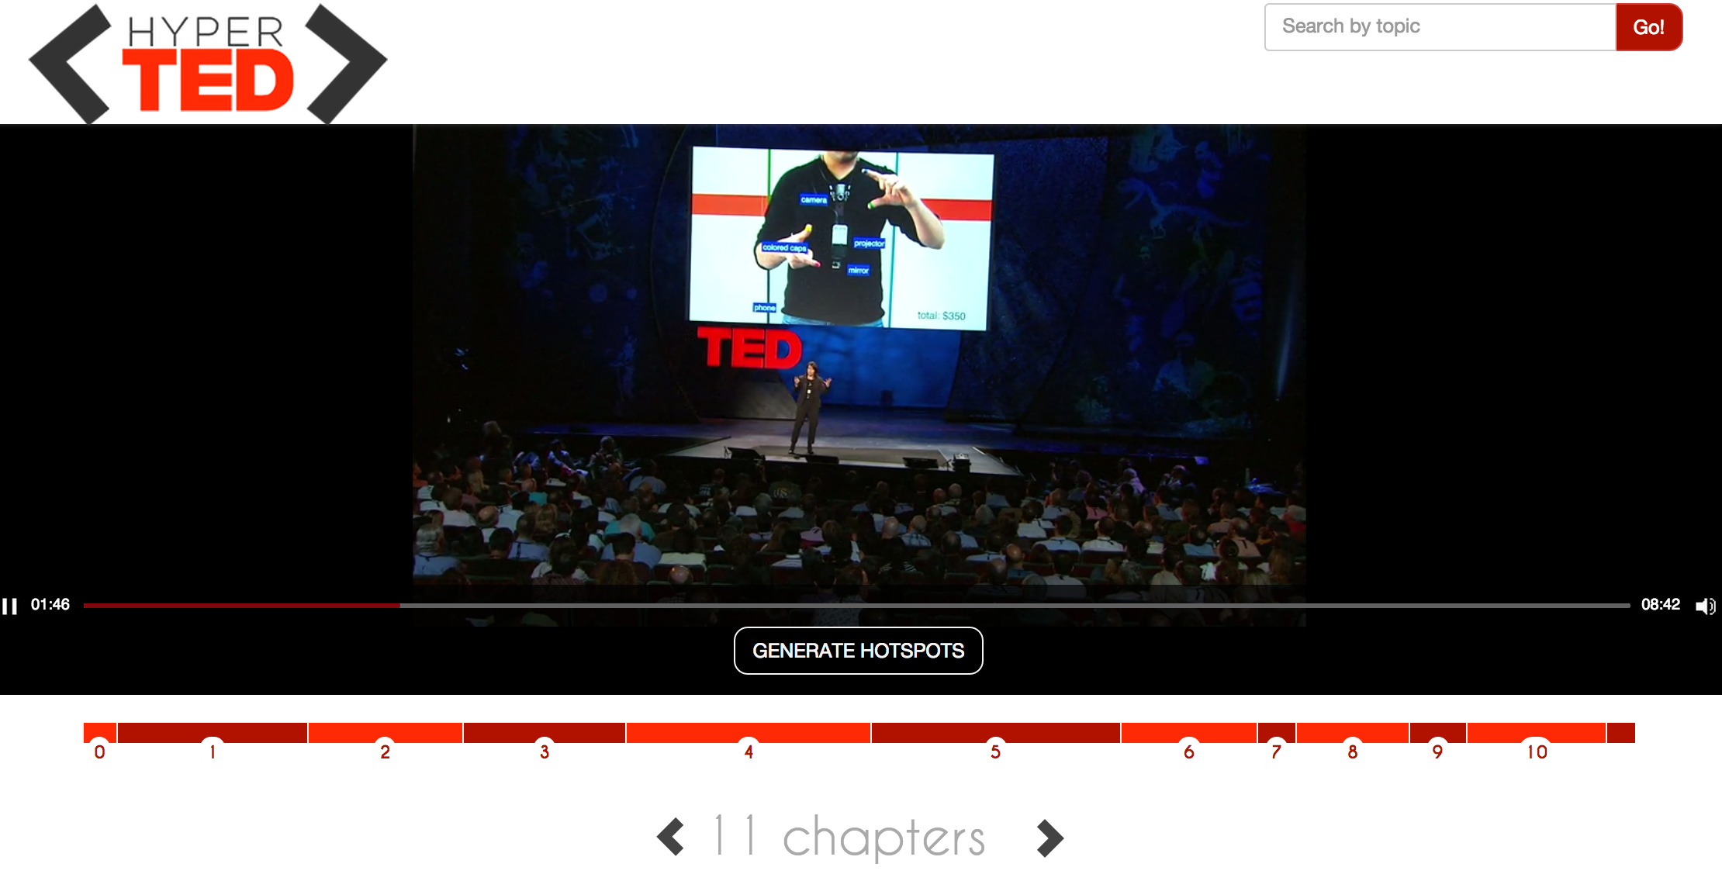

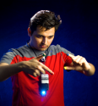
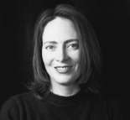


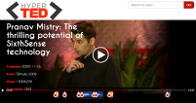
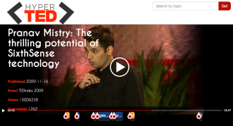





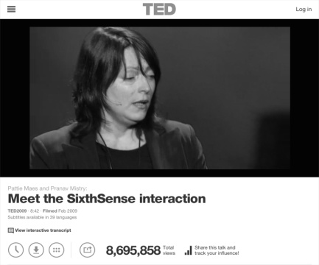








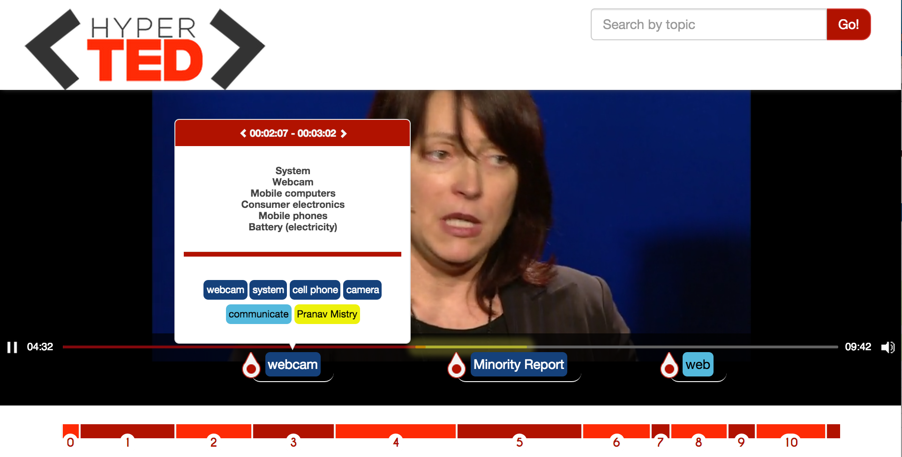
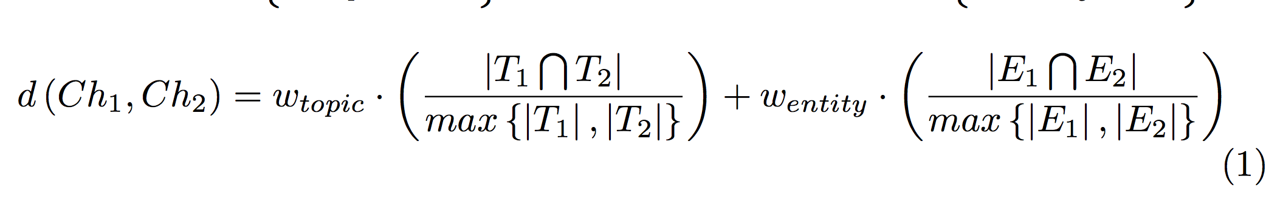

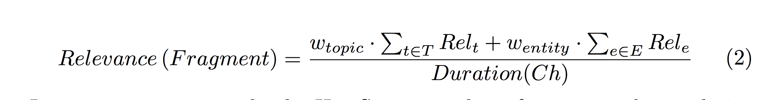

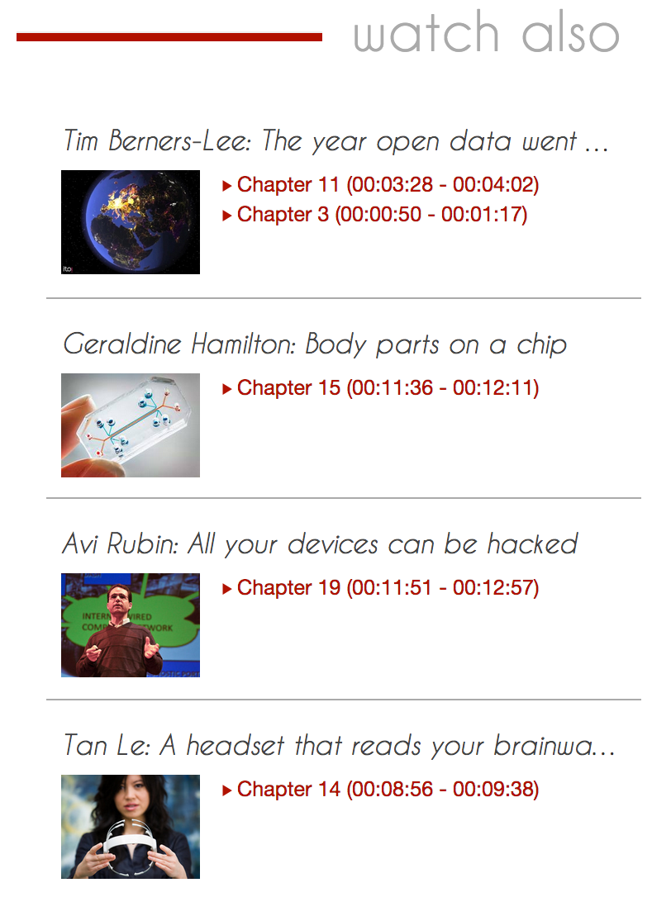
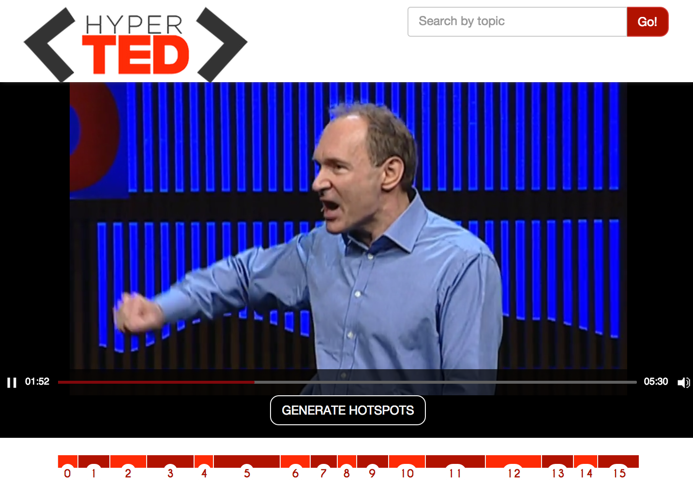
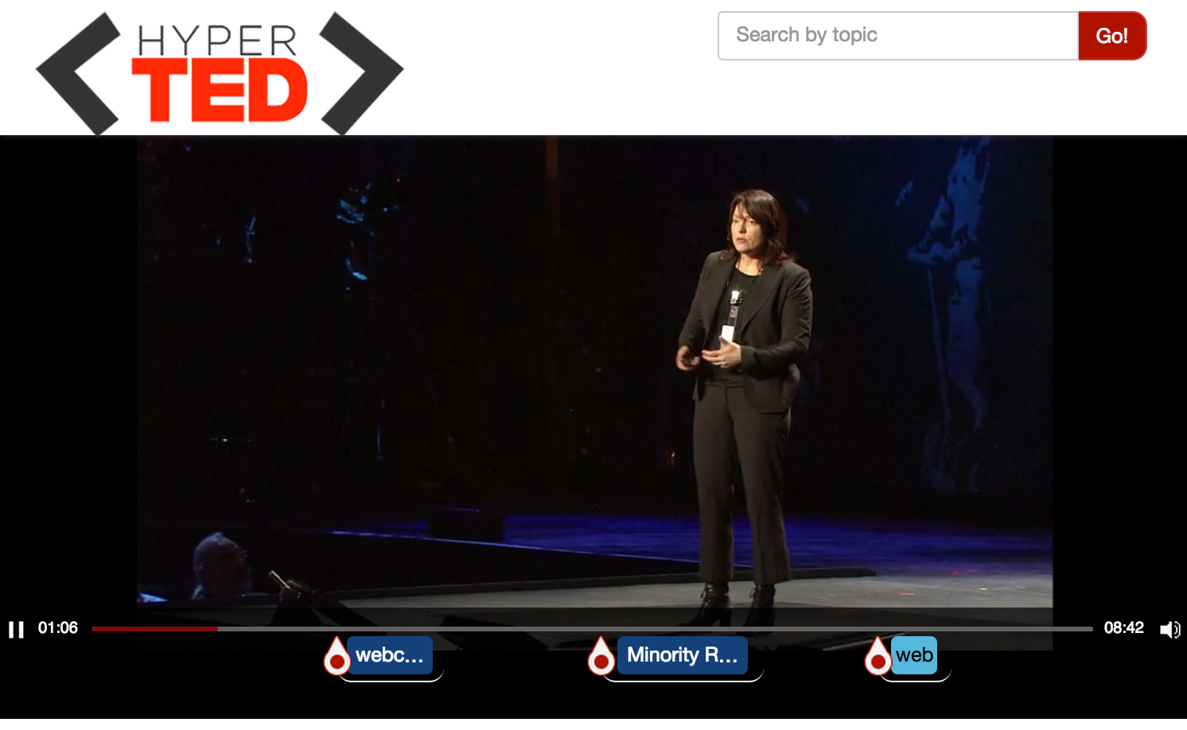
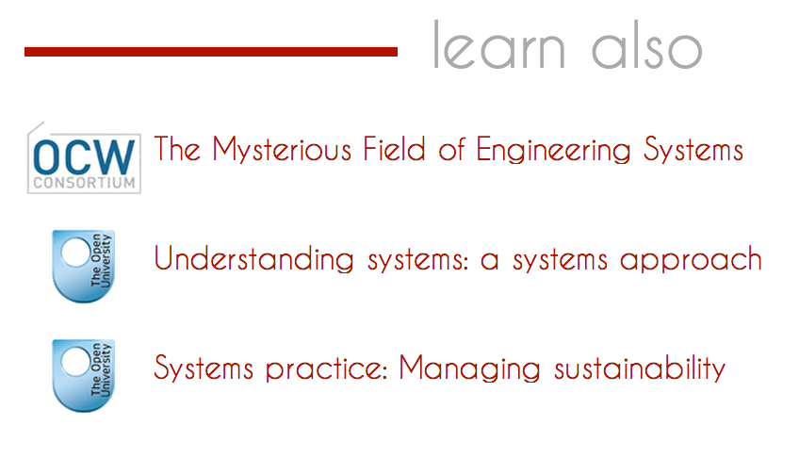



Searching and Browsing TED Talks
José Luis Redondo García, Mariella Sabatino, Pasquale Lisena, Raphaël Troncy
{redondo, mariella.sabatino, pasquale.lisena, raphael.troncy}@eurecom.fr
HyperTED: empowering TED Talks
Annotating Media Fragments
2014
TED Talks paragraphs: a human-made subdivision of subtitles
Hot spots
TED CHAPTERS
Chapters
Related Ted’s Chapters
Entities
2006
.com
Understanding environment:
A system approach
The Mysterious Field of Engineering Systems
Courses
(1) Named Entities
(2) Topics
1984
Systems practice: Managing sustainability
“This is Nikita, a security guard from one of the bars in St. Petersburg.”
“I'm wearing a camera, just a simple webcam, a portable, battery-powered projection system with a little mirror. These components communicate…
“This is Nikita, a security guard from one of the bars in St. Petersburg.”
Battery (electricity)
Mobile computers
Consumer Ele..
Hot Spots: highlighting important fragments
Clustering of consecutive chapters which are about similar topics and entities
Ordering of those fragments based on annotation relevance (TF-IDF)
Filtering the fragments whose relative relevance falls under the first quarter
Hyperlinking: TED Chapters
Hyperlinking: Online Courses
Features indexed:
Granularity level:
Datasets:
Anchors in search:
Attributes in search:
Topics
Entities
time code references (startNPT ; endNPT)
extractor confidence
Full text transcript
Chapter
Open Courseware
Open University
Entities Too specific
Topics Courses’ thematic
Title
Description
Subject, thematic, …
Feeding TV Application
References
[1] Y. Li, G. Rizzo, J. L. R. García, R. Troncy, M. Wald, and G. Wills. Enriching Media Fragments with Named Entities for Video Classification. In 1st International Workshop on Linked Media (LiME’13), pages 469–476, Rio de Janeiro, Brazil, 2013.
[2] J. L. R. García, M. Hildebrand, L. Perez Romero and R. Troncy. Augmenting TV Newscasts via Entity Expansion. In 11th Extended Semantic Web Conference (ESWC'14), Demonstration Track, Crete, Greece, 2014.
Notes:
Base pour concevoir votre poster EURECOM.
Le service COM est à votre disposition pour toute aide complémentaire

